Slide 1
Team 5C Project

Slide 2

Overview
Users can write reviews for music i.e. albums, singles, eps and gigs. The user can choose to review music that is already in the website’s database or add new music to the database.

Slide 3

Personas (1) (Craig)
General Description: Bryan is a casual music listener, who uses music streaming services to listen to music. He is not particularly invested in a specific genre or artist. He generally listens to music whilst working or unwinding at the weekends. He appreciates good, new music. However, he does not have an abundance of time to extensively explore new artists and tracks.
Name: Bryan Smith
Occupation: Electrician
Age: 26
Goals: Bryan wishes to find great music previously unfamiliar to him. He wants a music review site that provides easy-to-access information that prioritises the most popular reviews at the fore-front of the site for accessibility. He also values public-opinion, so he views the site’s users’ favourite picks as a means for him to immediately find what is popular on the review site at the moment.
Critical Needs: an easy to navigate site with clear and easy to understand user-interfaces. He also needs to easily find the most-popular, or trending, reviews to quickly access the best music available to him as soon as he logs onto the site. Whilst browsing reviews themselves, he need them to provide a clear and visible overall star rating.

Slide 4

Personas (2)
General Description: Stacey has a passion for music. She works as a music teacher in a school, spending much of her free-time exploring a variety of musical genres, artists and attending gigs. She enjoys conversing regarding new, exciting music with other like-minded people as well.
Name: Stacey Kent
Occupation: Music Teacher
Age: 32
Goals: Stacey is looking for a music review site to allow her to share her in-depth analysis, opinions and critiques on music she has been listening to, or gigs she has attended recently. But she also wishes to use the site as a means to engage in discussions with like-minded people regarding their reviews of a diverse selection of music.
Critical Needs: a proficient search and filtering system to explore the posted reviews to allow her to find, and sort through, newly posted reviews of music and gigs she may be interested in. Also, the ability to communicate, in the form of comments, on others’ posted reviews of music in an easy-to-use manner.

Slide 5

Personas (3)
General Description: Patrick works as a journalist, specialising in the field of music. He actively writes reviews on gigs, festivals and albums. His opinions have a strong influence on his readers. He has an in-depth knowledge of the music industry and works closely with record companies to look for up and coming talent.
Name: Patrick Davidson
Occupation: Journalist
Age: 47
Goals: Patrick wishes to use the music review site as a means to keep up to date with the new music as best as he can. He also wishes to explore public opinions to help him research his own articles. He values active users’ opinions, and aims to stay well-informed with other passionate music lovers’ taste, to allow him to stay relevant and informative in the field of his work.
Critical Needs: Patrick needs to easily access the site’s latest reviews posted for music and gigs. He also needs to be able to view other reviewers’ profiles so he can explore active users’ opinions and what music they have been listening to lately.

Slide 6
specification
User Registration and Profiles: Allow users to create accounts, personalise their profiles, and track their music review history.
Review Posting: Enable users to write and post their reviews for albums or tracks, including rating them on a predefined scale.
Comment System: Allow users to comment on reviews and engage in discussions with other music enthusiasts.
Search Functionality: Enable users to search for artists, albums, or tracks using various filters (e.g., genre, release date, artist popularity).

Slide 7
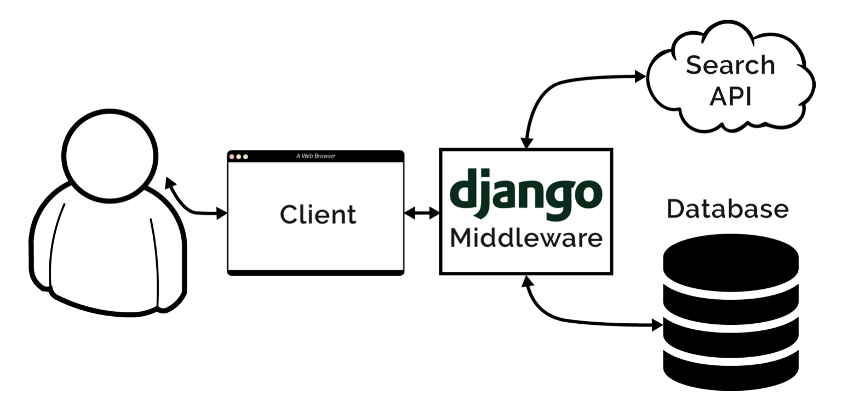
system architecture diagram

Slide 8
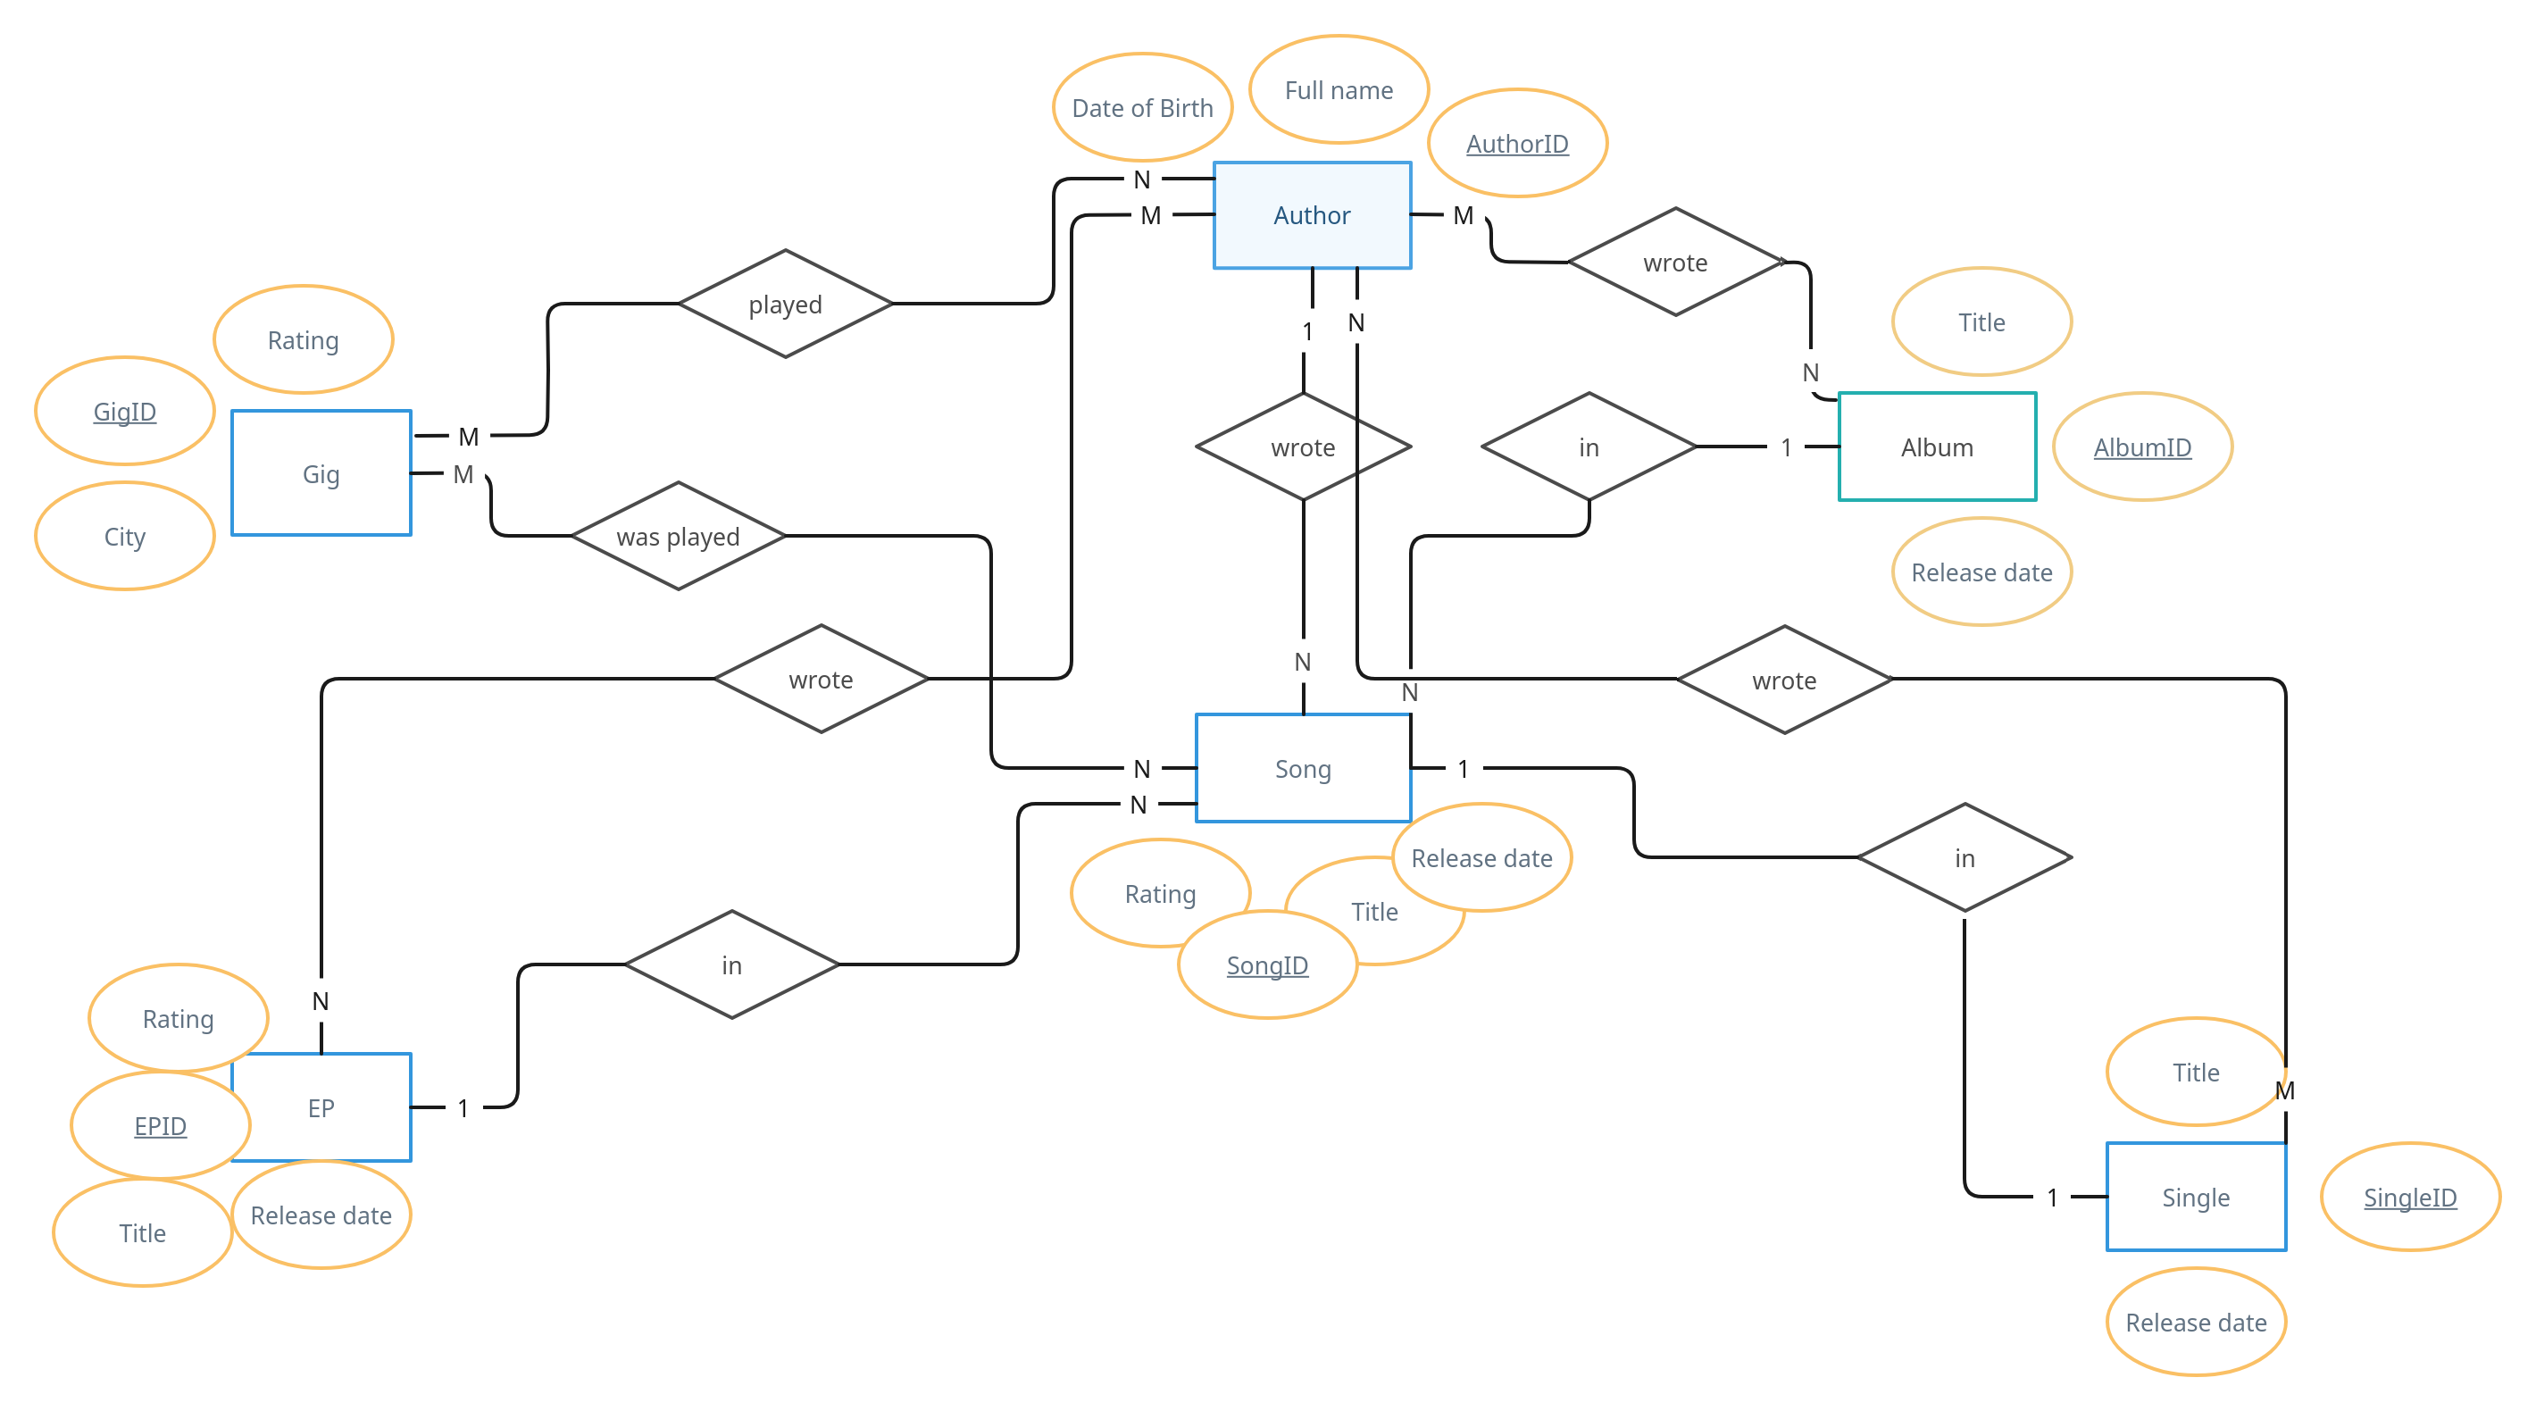
ER Diagram

Slide 9
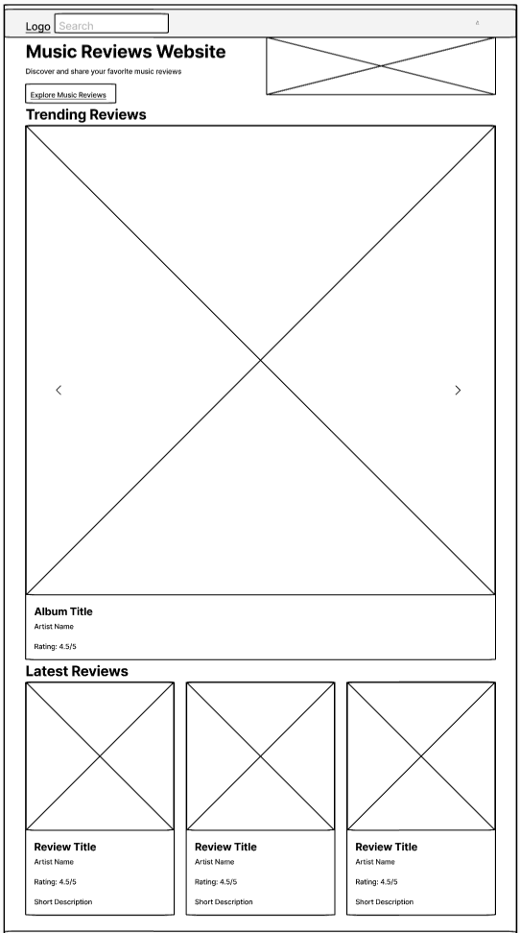
Wireframes - Home
Login

Slide 10
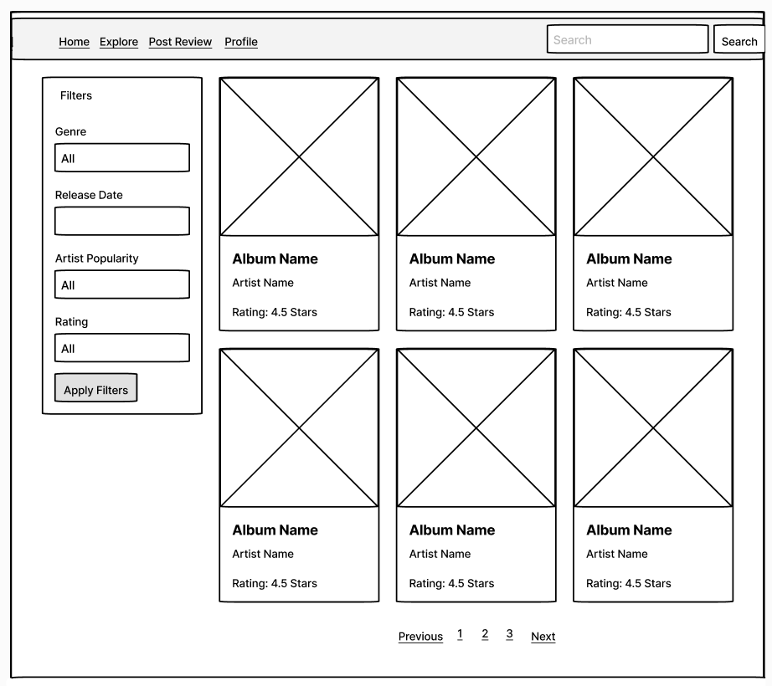
Wireframes - Explore

Slide 11
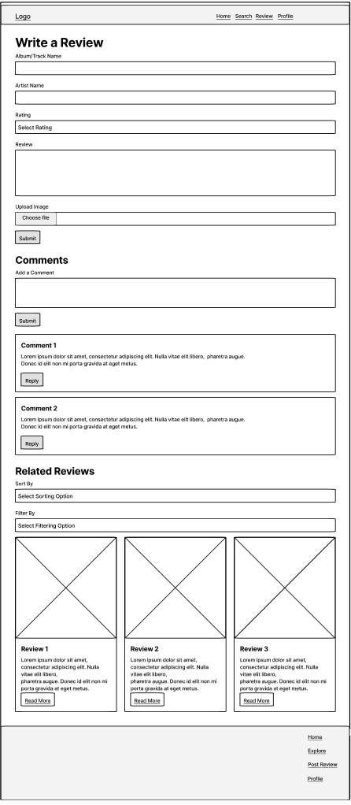
Wireframes – Write review

Slide 12
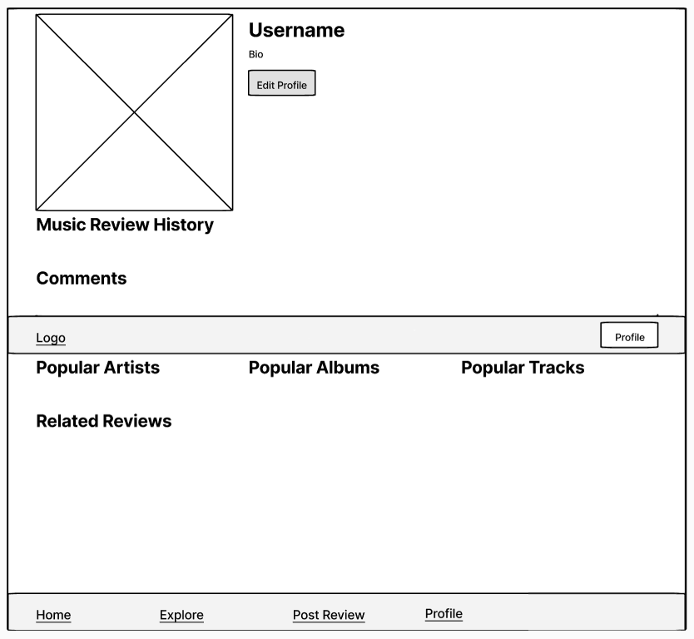
Wireframes – User Profile

Slide 13
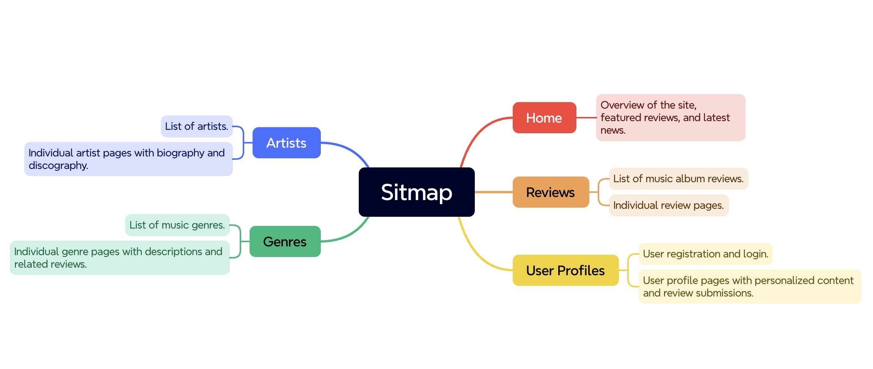
Site map

Slide 14
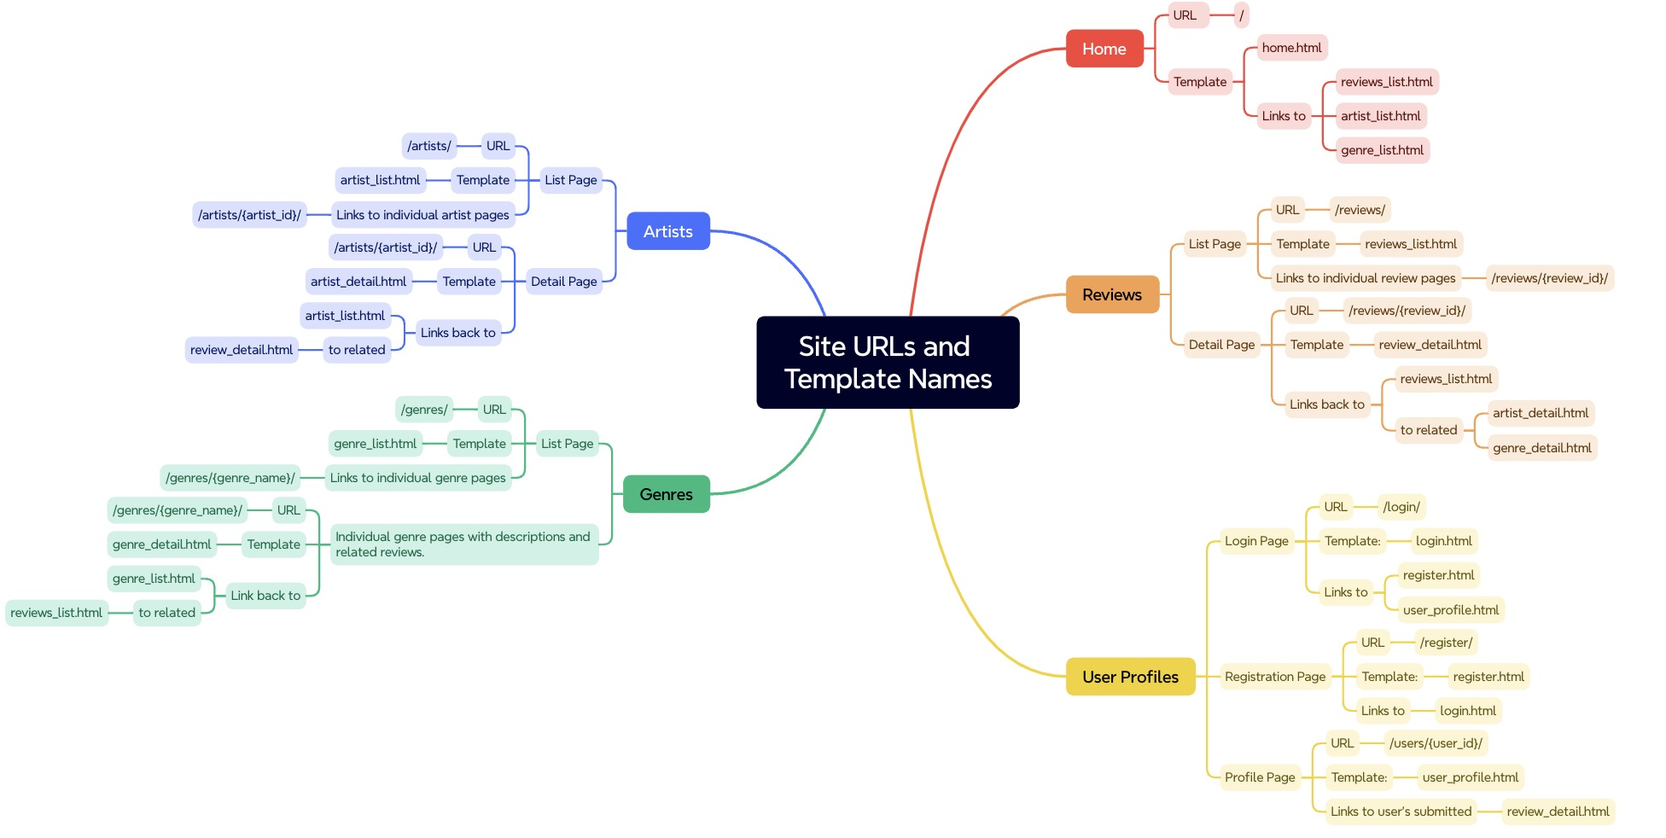
walkthrough

